Slide 1


Smart Disaster Early Warning & Rescue Assistance
LoRa-Based Infrastructure-Independent System
TEAM NAME
TEAM MEMBERS
TEAM ID
Team Predator
Gaurav Mohan Dikey (C)
Aryan Nilesh Metkar
Kartik Hemantkumar Jaiswal
CW123

Slide 2

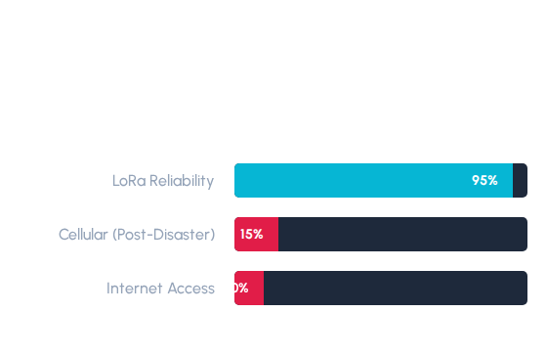
THE Problem
Communication Gap
Natural disasters like floods , earthquakes , and fires create sudden emergencies.cause immediate infrastructure collapse. Standard networks (Cellular/Internet) fail exactly when needed most.
Critical Pain Points
Infrastructure Dependency in rural areas.
Delayed Warning leading to loss of life.
High Power Costs for satellite alternatives.
Inaccessible Rescue information.

Slide 3





THE SOLUTION
Lora Practical Solution
Core Idea
Early Warning
Rescue Display
A long-range wireless rescue system that operates independently of existing mobile grids and internet.
Distributed sensor nodes detect water rise, vibrations, or forest fire, across several kilometers.
Base stations decode precise GPS coordinates and environmental data for immediate rescue deployment.

Slide 4
TECHNICAL ARCHITECTURE
Sensing
Processing
Localization
Transmission
Base Alert
Environmental data captured by field nodes.
ESP32 converts raw values & checks thresholds.
GPS embeds exact Lat/Long in alert packets.
LoRa SX1278 sends data over ISM bands.
SIM800L forwards SMS to authorities.

Slide 5
HARDWARE COMPONENTS
Module | Model | Specific Disaster Application
Processor | ESP32 MCU | Central logic, decision making, and deep-sleep power management.
Communication | LoRa SX1278 | Infrastructure-free, long-range wireless data link (P2P).
Location | NEO-6M GPS | Exact node coordinates for rescue team navigation.
Water Monitor | HC-SR04 | Ultrasonic detection of flood water rising levels.
Seismic/Tilt | MPU6050 | Landslide prediction and earthquake vibration detection.
Emergency SMS | SIM800L | GSM bridge at base station to alert mobile networks.

Slide 6

ENGINEERING CHALLENGES
Power Management (Solar/Sleep)
Long-Range Signal Stability
Sensor Calibration/Noise
Weatherproof Packaging
False alarm reduction and GPS fix delays remain critical optimization targets for dense forest areas.

Slide 7
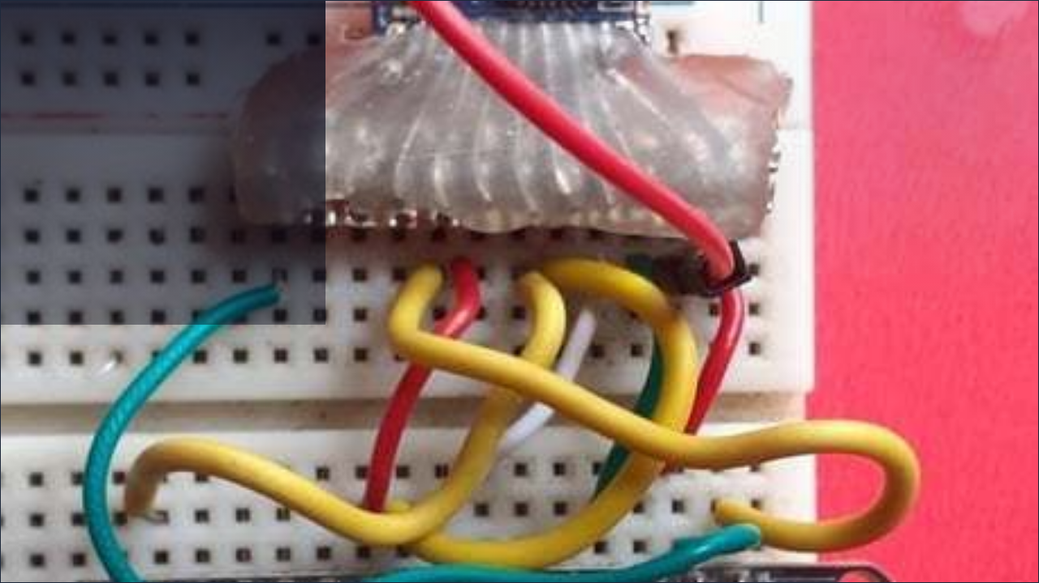

LIVE DEMO
Observe the real-time sensor data transmission from the LoRa Node to the Base Station LCD Interface.

Slide 8

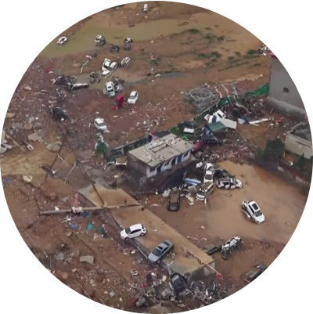
PROJECT IMPACT
Faster Warning Delivery: Instant alerts reduce evacuation response time.
Improved Rescue Coordination: GPS tracking directs help to exact victim locations.
Rural Accessibility: Connects communities that are ignored by mobile carriers.
Low-Cost Public Safety: Affordable alternative for local disaster management authorities.

Slide 9

FUTURE SCOPE
Edge AI Integration: On-device disaster prediction models.
District-Wide Mesh: Expanding nodes into a self-healing grid network.
Auto Victim Tracking: Wearable tags for real-time location updates.
Govt. Integration: Direct feed into national emergency response systems.

Slide 10
Conclusion
Our model provides a simple, affordable, and reliable communication system. By removing infrastructure dependency, we make disaster management faster, smarter, and more effective.
Questions?
Team Alpha-Node | Contact: [Insert Email]

Slide 11



IMAGE SOURCES
https://www.jouav.com/wp-content/uploads/2022/07/henan-flood-oblique-imagery-1024x471.jpg
Source: www.jouav.com
https://plus.unsplash.com/premium_photo-1755873911560-4e007f722c16?fm=jpg&q=60&w=3000&auto=format&fit=crop&ixlib=rb-4.1.0&ixid=M3wxMjA3fDB8MHxwaG90by1yZWxhdGVkfDE3fHx8ZW58MHx8fHx8
Source: unsplash.com
https://content.instructables.com/FBA/9S9Q/KA8Y2IOA/FBA9S9QKA8Y2IOA.jpg?frame=true&width=1024&height=1024&fit=bounds&crop=2:3
Source: www.instructables.com

